Slide 1


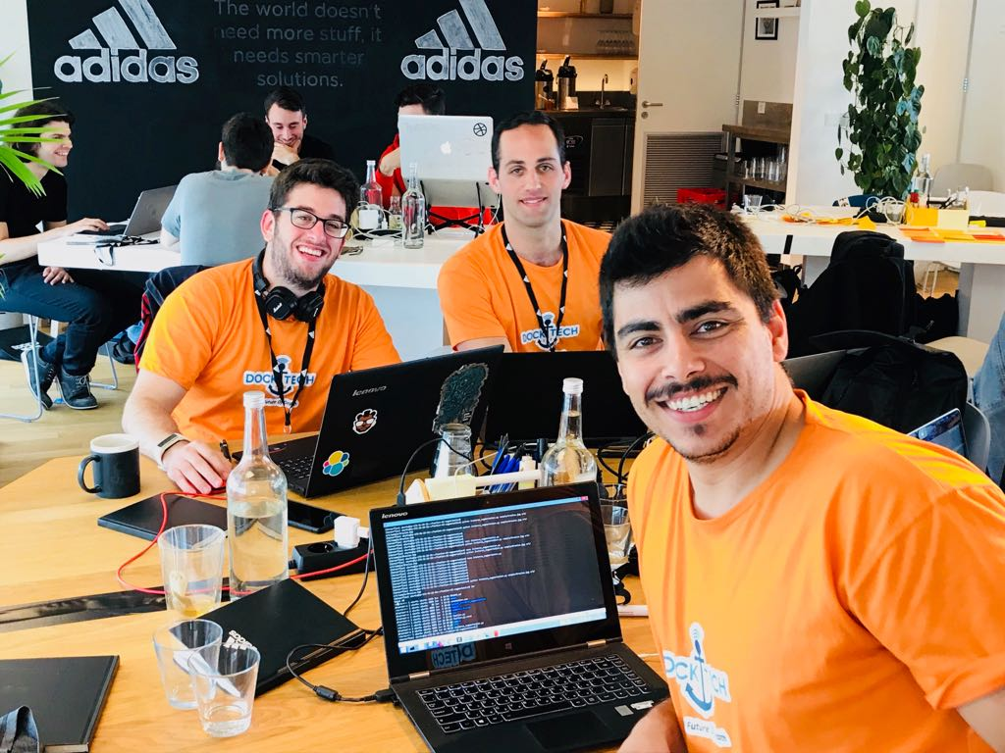


DockTech
TEAM PICTURE
Adar Granot
Uri Yoselevich
Dor Zimberg
Personelized Online Experience
Deep Learning
TECHNOLOGIES
Big Data
Image Proccessing

